Slide 1
Documentation and Metadata
Alexander Botzki and Bruna Piereck
This material contains extracts and adaptations from the “Metadata & Findability” session of “FAIR training material made by design” course, CCBYSA

Slide 2
Which kinds of data/documents we have?
Samples
Protocols / Resources of Products
Images
Code
Data (e.g. readouts - various file formats, …)
Presentations, Posters
Articles
Documentation
Notes:
https://docs.google.com/presentation/d/1ZcFJpbXtxT4Qa6wgffV_oEX8_cZfzM8B-VlMH0Cff0I/edit#slide=id.g301c2976dd9_0_8

Slide 3
Data vs Metadata
Data itself
Data descriptor (metadata)

Slide 4
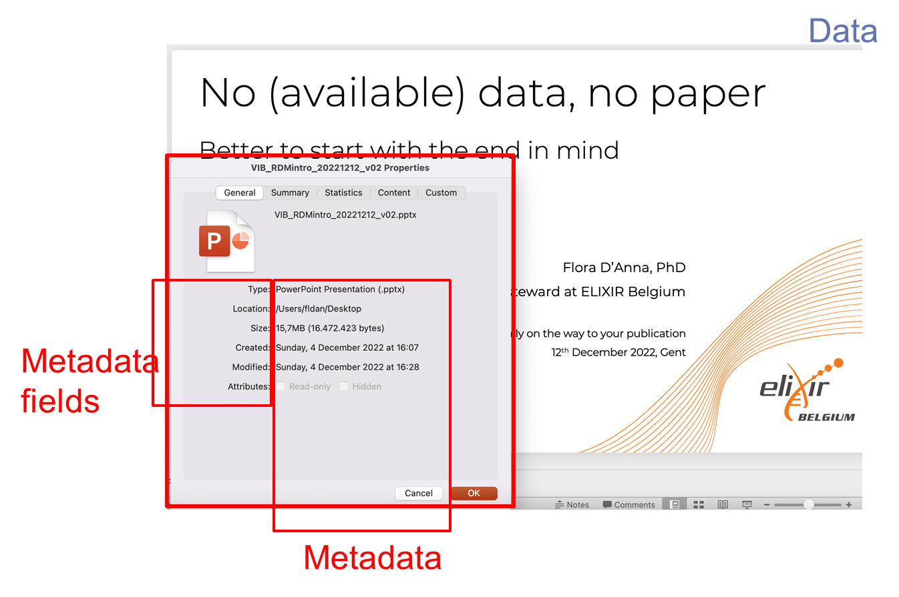
Example borrowed from the session “No (available) data, no paper” by Flora D’Anna
Notes:
Example of data [slides] and metadata [specs of the presentation]

Slide 5

General consideration with the publishing in mind
Write the documentation in such a way that someone else who is known to the field can not mis-interpret any of the data, even if they tried.
By stockking
on freepik.com
https://rdmkit.elixir-europe.org/metadata_management
Notes:
https://www.freepik.com/free-photo/impressed-young-guy-student-wearing-backpack-with-glasses-holding-looking-book-scratching-head-isolated-orange-wall_17547116.htm#fromView=search&page=1&position=27&uuid=2d03d162-447c-4c25-b52b-22e0f295beed

Slide 6


General consideration with the publishing in mind
Documentation at two levels
Project/Study level: Title Summary Aims Authors Funds Methods License Data sets ID Folder structure File naming
Data-level: documentation
By pch.vector on freepik.com
By freepik
https://rdmkit.elixir-europe.org/metadata_management
Notes:
https://www.freepik.com/free-vector/hand-drawn-gathering-data-business-concept_20289426.htm#fromView=search&page=1&position=8&uuid=13dd6e82-c796-4538-9fb2-ffd0657164cc
https://www.freepik.com/free-vector/male-hand-holding-folder-with-documents-flat-vector-illustration-businessman-holding-red-file-important-business-real-estate-documents-stationery-application-meeting-concept_27572968.htm?log-in=google#fromView=search&page=1&position=7&uuid=07b0b1f1-775b-4fc7-8932-41366a0bc153

Slide 7

General consideration with the publishing in mind
Both the study- and data-level documentation must be:
Generated as early as possible in the research process
Maintained, in order to be accurate and complete
By vectorjuice on freepik.com
https://rdmkit.elixir-europe.org/metadata_management
Notes:
https://www.freepik.com/free-vector/cloud-collaboration-abstract-concept-illustration_20770245.htm#fromView=search&page=1&position=2&uuid=ec61cc9f-27ed-477b-b71e-96b38e6a1678

Slide 8
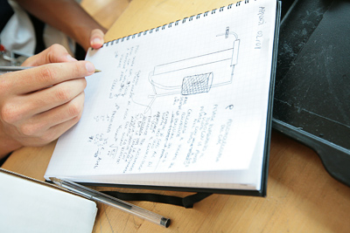

Why would I use an ELN for documentation?
eLab journal - 19Nov - Leuven
eLab journal - 09Dec - Gent
Paper replacement
Project-based system
Share data
Experiments, protocols, ...
Standardization of experiments
Templates
Intellectual property protection
Data stored in central database
Eventually Office integration
MS Office: Word, Excel, PowerPoint
Search function
Advanced search

Slide 9










Project-based system
Project
Notebook Subproject
Experiment
Section
User
User Configuration
Templates, View Folder, …
VIB Research Center
Lab/User group
Group Project
Group Configuration
Templates, Reagents Folder, …
Notes:
What type of information would you document on the various levels?
What is missing on this slide?

Slide 10

Looking into one document: My material and methods
By rawpixel.com at frepik.com
Notes:
https://www.freepik.com/free-photo/flowchart-information-methodology-operation-icon_18092018.htm#fromView=search&page=1&position=0&uuid=75da79d2-6d6f-4fa4-b976-c099b19183f1

Slide 11
How to write useful documentation?
Exercise:
In groups
Wet Lab
Data Analysis
You will analyse a document and define what could be improved to actually achieve reproducibility.

Slide 12
How to write useful documentation?
Exercise: wet lab protocols The resulting emulsion was collected in aliquots of 50 μL total volume and thermocycled according to the RT program (42°C for 90 min, 11 cycles of [50°C for 2 min, 42°C for 2 min], 85°C for 5 min, followed by a final hold on 4°C). 125 μL of recovery agent (20% PFO in HFE), 55 μL of GITC Buffer (5 M GITC, 25 mM EDTA, 50 mM Tris-HCl pH 7.4) and 5 μL of 1 M DTT was added to each separate aliquot of 50 μL thermocycled emulsion and incubated on ice for 5 min.
Exercise: data analysis scripts Barcode reads were trimmed to exclude the intersub-barcode linear amplification adapters using a mawk script. Reads were then mapped and cell-demultiplexed using STARsolo (Kaminow et al., 2021) in CB_UMI_Complex mode. The resulting STARsolo-filtered count matrices were further analyzed using Scanpy (Wolf et al., 2018). In short, cells were filtered on expression of a maximum of 4000 genes, and a maximum of 1% UMIs from mitochondrial genes. Genes were filtered on expression in a minimum of three cells. Potential cell doublets were filtered out using a Scrublet (Wolock et al., 2019) threshold of 0.25.

Slide 13
Discussion of results:

Slide 14
Annex exercise 2
https://www.protocols.io/view/hydrop-rna-v1-0-dm6gpwqjjlzp/v2?step=5 While RT is on, you can prepare GITC buffer and other components necessary in the later steps. Droplet Breaking and Purification
Now, we will break all the droplets and purify the cDNA, which is the result of our in-droplet reverse transcription reaction.
https://www.protocols.io/view/hydrop-rna-v1-0-dm6gpwqjjlzp/v2?step=6.1

Slide 15
How to document scripts and code
Exercise 2 part 2 data analysis scripts Barcode reads were trimmed to exclude the intersub-barcode linear amplification adapters using a mawk script. Reads were then mapped and cell-demultiplexed using STARsolo (Kaminow et al., 2021) in CB_UMI_Complex mode. The resulting STARsolo-filtered count matrices were further analyzed using Scanpy (Wolf et al., 2018). In short, cells were filtered on expression of a maximum of 4000 genes, and a maximum of 1% UMIs from mitochondrial genes. Genes were filtered on expression in a minimum of three cells. Potential cell doublets were filtered out using a Scrublet (Wolock et al., 2019) threshold of 0.25.

Slide 16
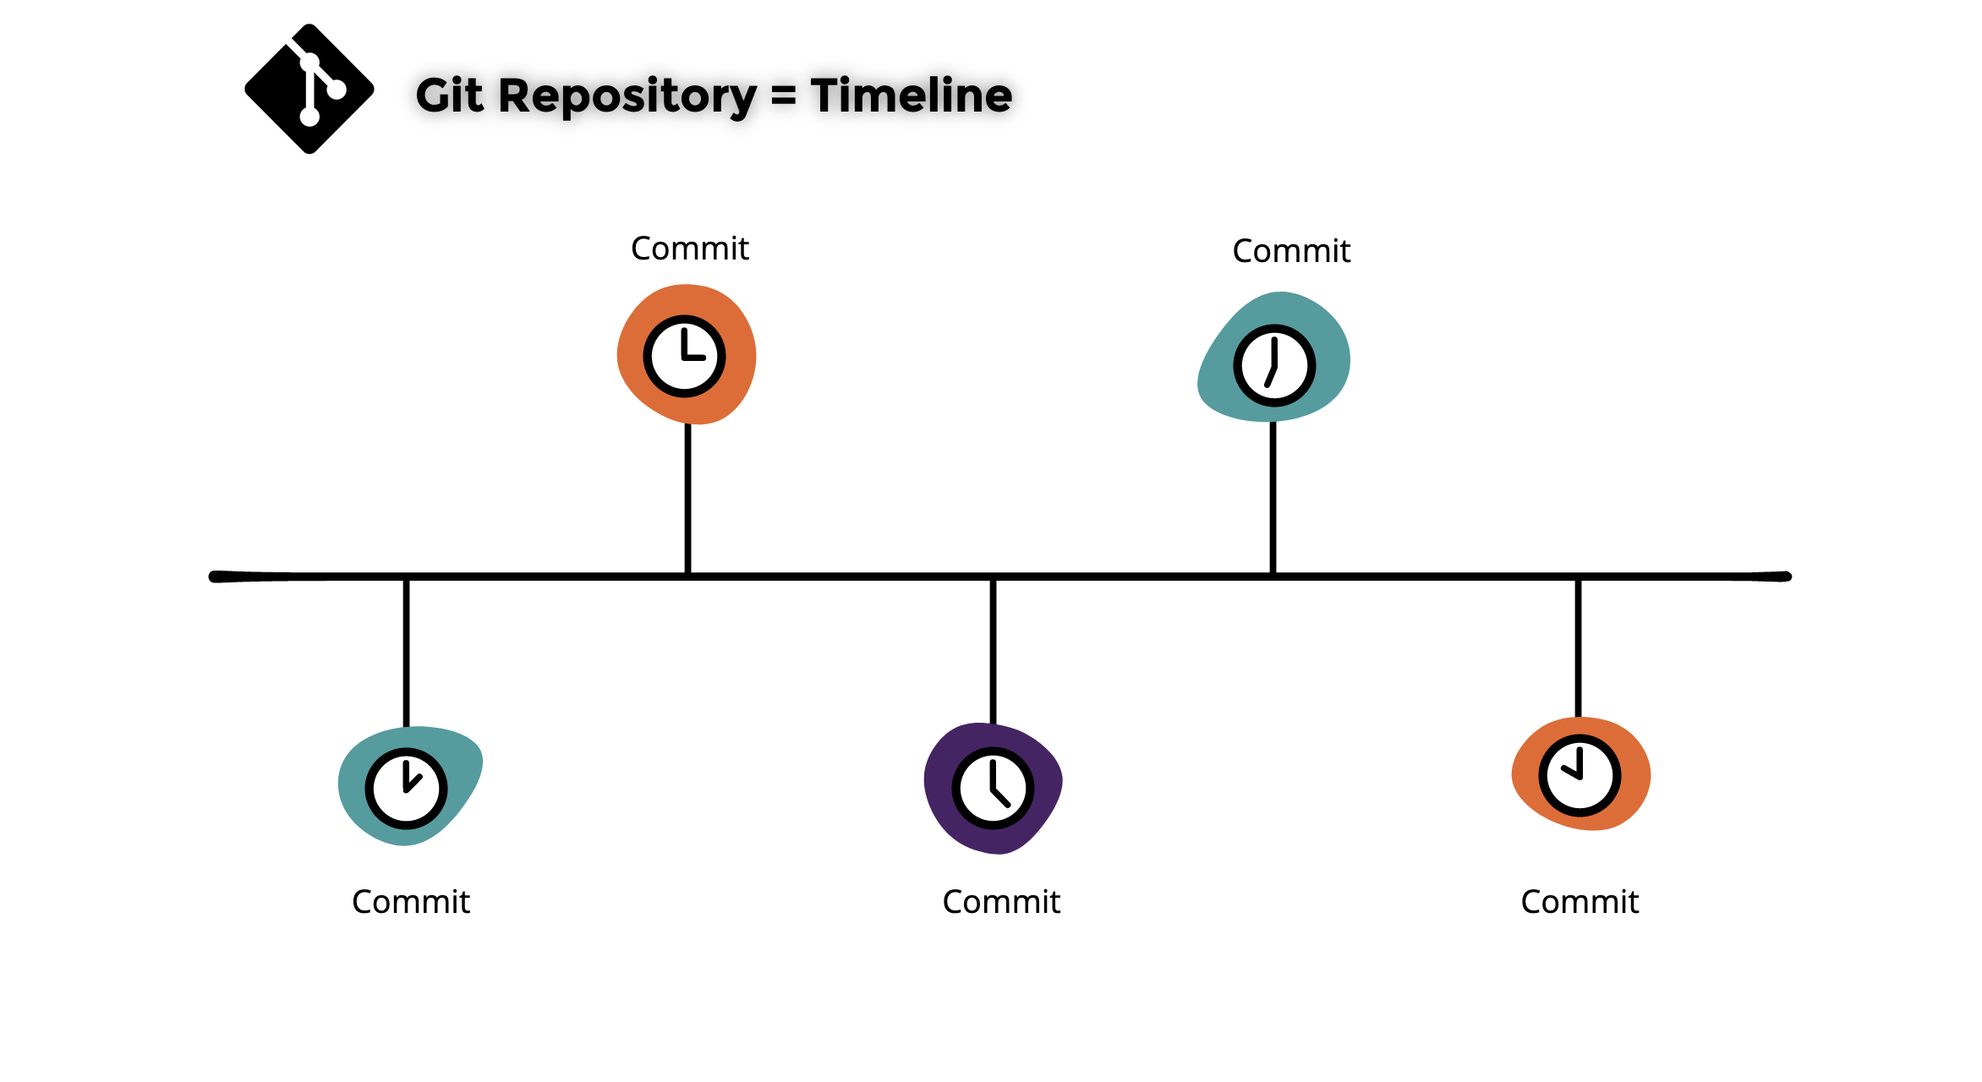
Data analysis scripts under version control
The best possible way of documenting scripts and code for software is using git and github (or alternative online ‘backup’ solution to github).
Illustration borrowed from the “Introduction to Git & GitHub” course by Bruna Pierecka and James Collier, ccby 4.0

Slide 17
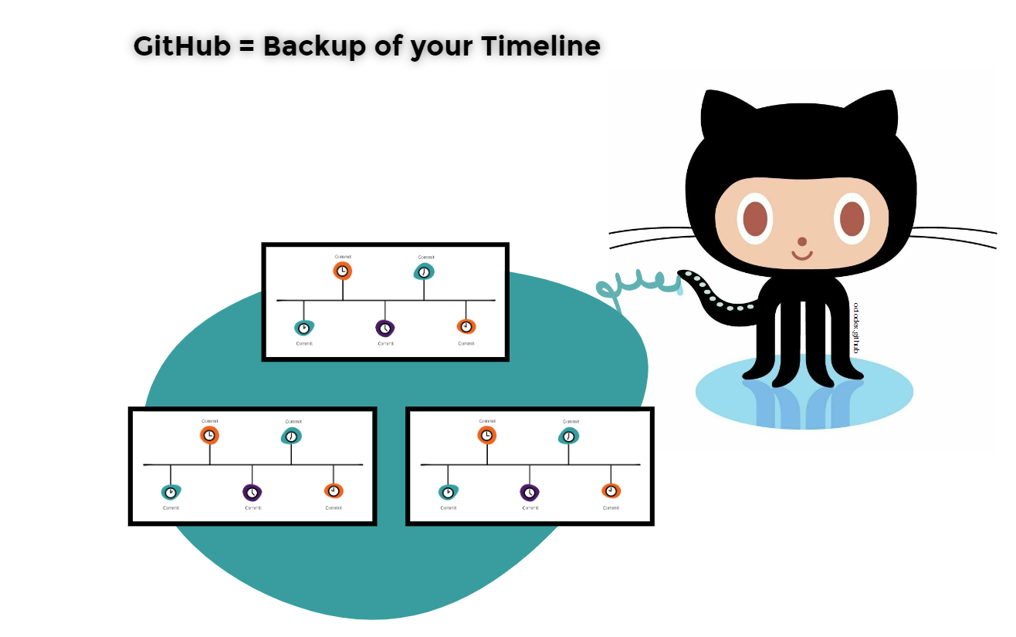
Data analysis scripts under version control
The best possible way of documenting scripts and code for software is using git and github (or alternative online backup solution to github).
Illustration borrowed from the “Introduction to Git & GitHub” course by Bruna Pierecka and James Collier, ccby 4.0
Notes:
git clone https://github.com/aertslab/hydrop_data_analysis.git
Launch ungit in the folder /Users/albot/hydrop_data_analysis

Slide 18
Data dictionaries and codebooks
Let’s explore this example The association between rainforest disturbance and recovery, tree community composition, and community traits in the Yangambi area in the Democratic Republic of the Congo
Information and data analyses and plots: https://zenodo.org/record/6979778#.Y5d1ZbLMKeM Publication: https://doi.org/10.1017/S0266467422000347

Slide 19
What’s in the paper? Zoom in on metadata
Data availability The data discussed in this publication have been deposited in NCBI's Gene Expression Omnibus and are accessible through GEO Series accession number GSE175684
A copy is available in the European Nucleotide Archive at PRJNA733185

Slide 20
What do you know about metadata?
?

Slide 21


Metadata
By freepik.com
By juicy_fish
Human findable
Machine findable
Slide borrowed from “Metadata and Findabilty” session, by Bruna Piereck and Alexander Botzki; from “FAIR material made by design” course, ccbysa
Notes:
https://docs.google.com/presentation/d/1ZcFJpbXtxT4Qa6wgffV_oEX8_cZfzM8B-VlMH0Cff0I/edit#slide=id.g301c2976dd9_0_8
https://www.freepik.com/icon/search_1705952#fromView=search&page=1&position=70&uuid=c9baea82-896a-4cee-bab6-c0bbb3af08a1
https://www.freepik.com/icon/technological-support_2408695#fromView=search&page=1&position=0&uuid=e9efa965-f219-42be-9003-dfd577db3888
https://www.freepik.com/icon/search_1705952#fromView=search&page=1&position=70&uuid=c9baea82-896a-4cee-bab6-c0bbb3af08a1

Slide 22
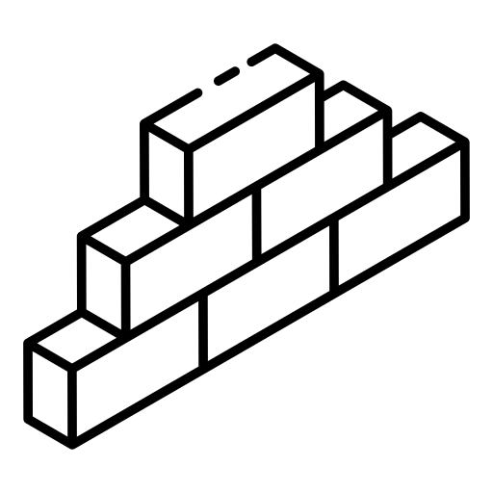


What is Metadata
Data to describe Data
Structured data
By smashingstocks
Descriptor with clear meaning
“Love note to the future about data”
By Iconsea
By Freepik
Slide borrowed from “Metadata and Findabilty” session, by Bruna Piereck and Alexander Botzki; from “FAIR material made by design” course, ccbysa
Notes:
https://www.freepik.com/icon/dictionary_12349225#fromView=search&page=1&position=11&uuid=947d3a74-8e87-4cba-952c-b5f3187bbd5c
https://www.freepik.com/icon/bricks_7007832#fromView=search&page=1&position=0&uuid=ab1d4a89-296c-44cd-89dc-5cc08e358eb4
https://www.freepik.com/icon/note_6546748#fromView=search&page=1&position=25&uuid=82875b0e-a9dc-4170-ad8f-bdc032877650
https://docs.google.com/presentation/d/1ZcFJpbXtxT4Qa6wgffV_oEX8_cZfzM8B-VlMH0Cff0I/edit#slide=id.g301c2976dd9_0_103

Slide 23
How is Metadata structured
By juicy_fish
Machine findable
Notes:
https://www.freepik.com/icon/search_1705952#fromView=search&page=1&position=70&uuid=c9baea82-896a-4cee-bab6-c0bbb3af08a1
https://www.freepik.com/icon/technological-support_2408695#fromView=search&page=1&position=0&uuid=e9efa965-f219-42be-9003-dfd577db3888
https://www.freepik.com/icon/search_1705952#fromView=search&page=1&position=70&uuid=c9baea82-896a-4cee-bab6-c0bbb3af08a1

Slide 24
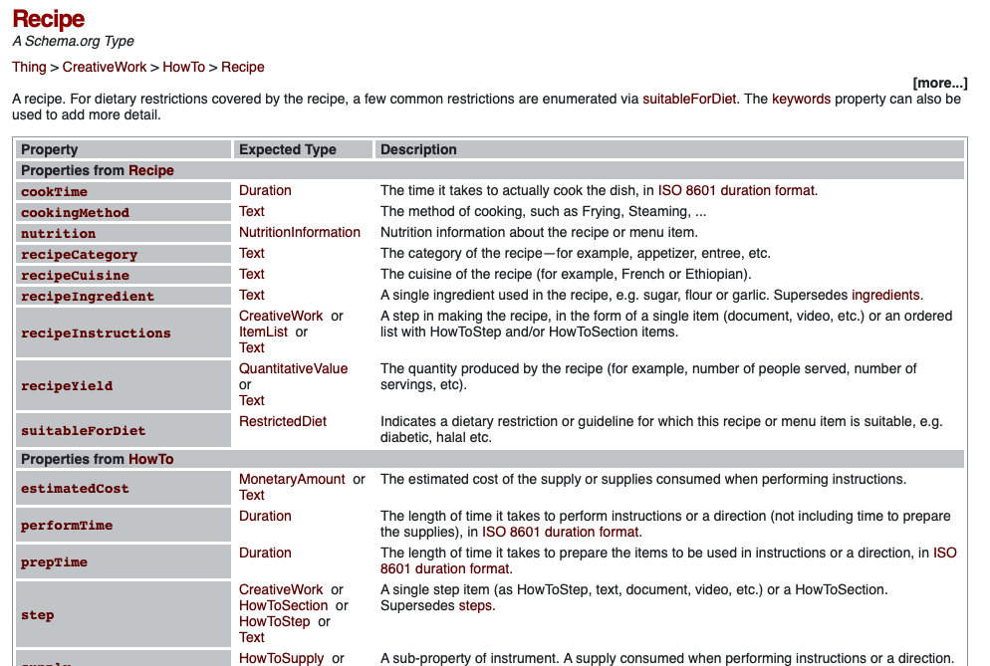
Type
Profile

Slide 25
Type
Profile

Slide 26


How does metadata works?
White chest of drawer with 3 drawers, depth between 40-50 cm, width between 70-80 cm, height between 75-80 cm.
Notes:
Activity description:
https://docs.google.com/document/d/12RsLx2vb1xESykDdljbTKWad-ZTgnqx_48MtIm9NeaU/edit?usp=sharing

Slide 27
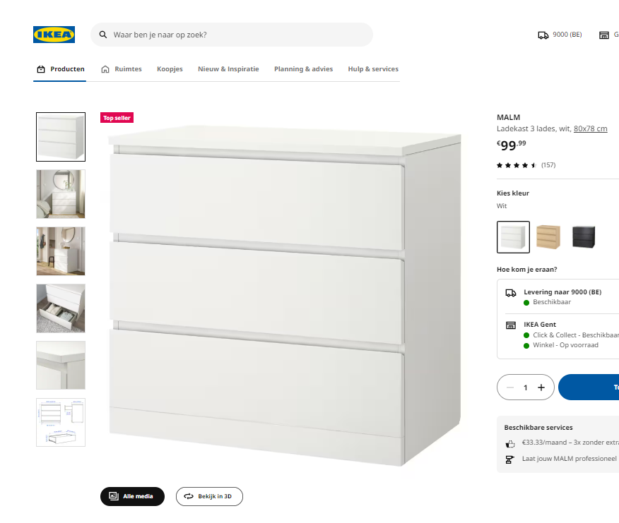
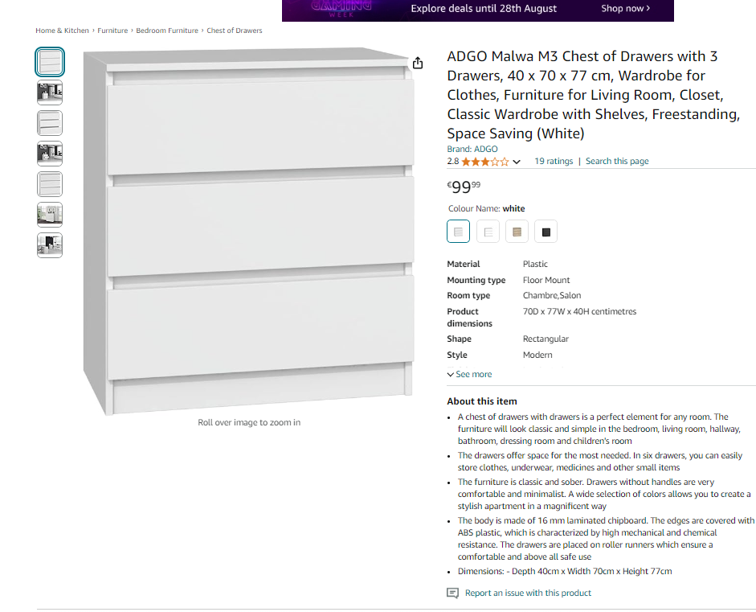
How does metadata works?
Notes:
Activity description:
https://docs.google.com/document/d/12RsLx2vb1xESykDdljbTKWad-ZTgnqx_48MtIm9NeaU/edit?usp=sharing

Slide 28


Metadata impact
Findability:
Findable by search engines
freepiik
juicy_fish
Sharing:
By UIcons
Structured information to evaluate
Targeted judgment
Evaluation on reusability
By UIcons
Decision making:
Slide borrowed from “Metadata and Findabilty” session, by Bruna Piereck and Alexander Botzki; from “FAIR material made by design” course, ccbysa
Notes:
https://www.freepik.com/icon/condition-alt_13727230
https://www.freepik.com/icon/together-people_15044474
https://docs.google.com/presentation/d/1ZcFJpbXtxT4Qa6wgffV_oEX8_cZfzM8B-VlMH0Cff0I/edit#slide=id.g301c2976dd9_0_8
https://www.freepik.com/icon/search_1705952#fromView=search&page=1&position=70&uuid=c9baea82-896a-4cee-bab6-c0bbb3af08a1
https://www.freepik.com/icon/technological-support_2408695#fromView=search&page=1&position=0&uuid=e9efa965-f219-42be-9003-dfd577db3888
https://www.freepik.com/icon/search_1705952#fromView=search&page=1&position=70&uuid=c9baea82-896a-4cee-bab6-c0bbb3af08a1

Slide 29
Ikea Ontologies
Let’s watch how Ikea approaches metadata.
https://zenodo.org/records/7908305

Slide 30
From metadata to data models
Let’s watch how Ikea approaches metadata.
https://zenodo.org/records/7908305

Slide 31
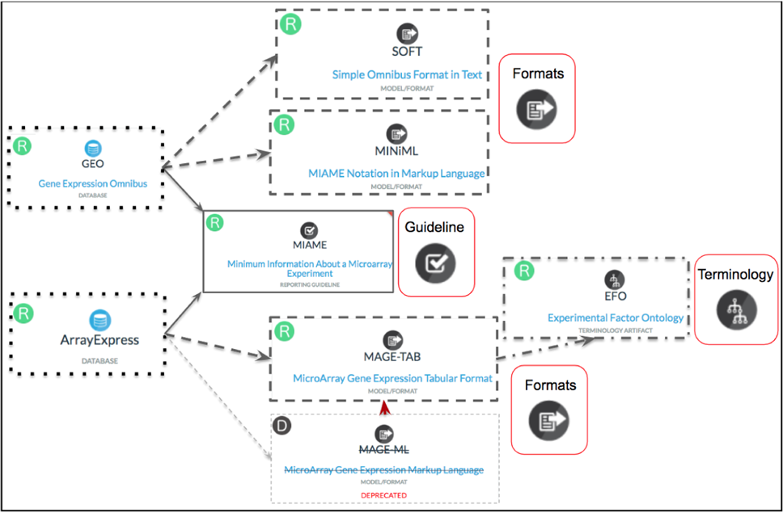
First a short excursion to nomenclature
Metadata model
Metadata checklist
https://doi.org/10.1038/s41597-022-01707-6

Slide 32

There are many metadata models
A metadata model is a structured framework that defines the types, relationships, and attributes of metadata within a specific context.
Essentially, it is a model that describes how metadata is organized and managed, providing a blueprint for how data about data is structured and utilized.
E.g. https://faircookbook.elixir-europe.org/content/recipes/infrastructure/dats-model.html

Slide 33
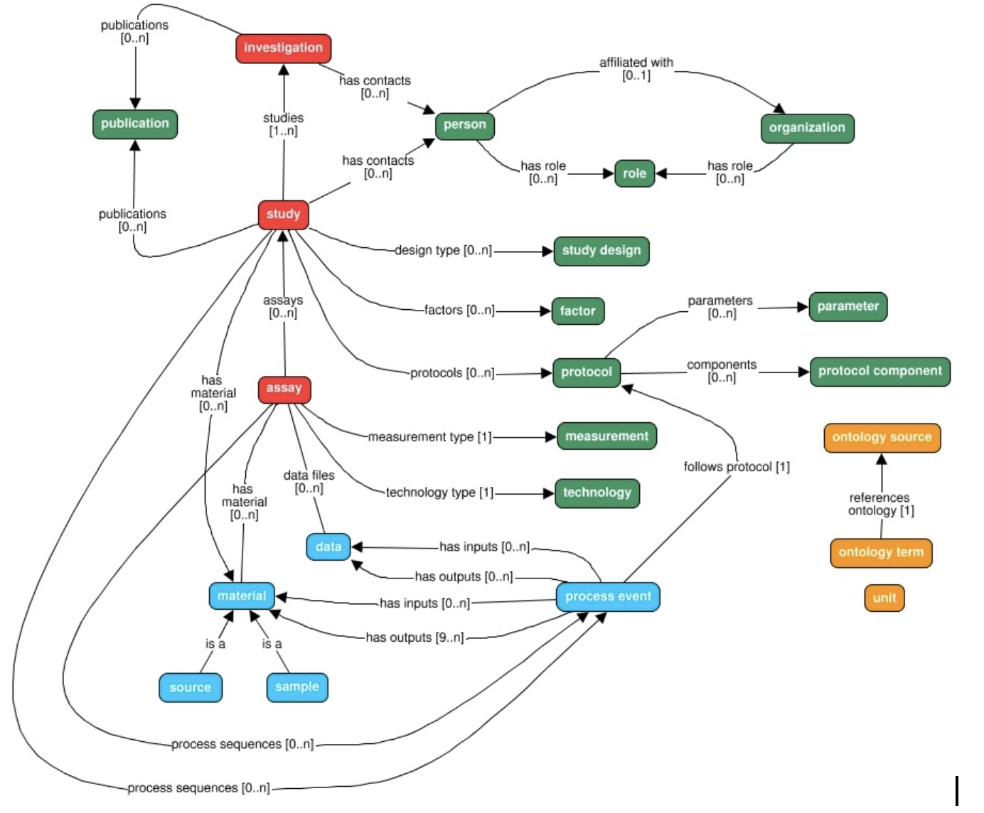
There are many metadata models
https://isa-tools.org/isa-api/_images/isa-model.png

Slide 34
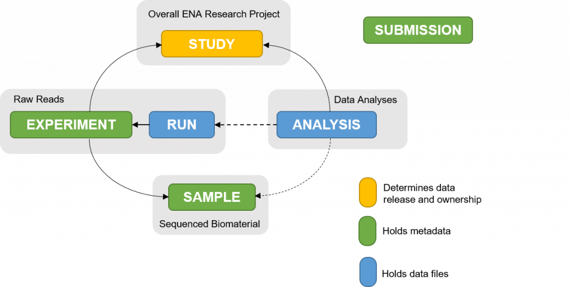
ENA’s metadata model
https://ena-docs.readthedocs.io/en/latest/submit/general-guide/metadata.html

Slide 35

Let’s focus on the metadata checklists
From ENA - their checklist of metadata
ELIXIR's Fair Cookbook for transcriptomics data
Exercise 3 Let’s fill in the metadata based on the paper

Slide 36
External references
Harvard Comparison Grid: https://datamanagement.hms.harvard.edu/electronic-lab-notebooks
NKI: LabGuru for Wetlab and Castor for Clinical Data Capature
MDC and BIH – LIMS is available, RDM SODAR (Omics data)

Slide 37
Documentation and support
VIB & ELIXIR Support
VIB Data Core - for e-lab journal (Follow training and Learn VIB support points)
eLab journal - 19Nov - Leuven
eLab journal - 09Dec - Gent
RDM more specific support should exist per center, taking their particularities in account
ELIXIR services - usegalaxy.eu More information at: https://www.elixir-belgium.org/services
Data Core Team Lead Data Management: flora.danna@vib.be

Slide 38





What did we cover today.
implement SOP type of approach for your daily documentation of experiments
describe the impact of documentation on the publication preparation
make versioning more persistent by using protocols.io and/or your Electronic Lab Notebook
use github for scripts and code
apply at least minimal metadata standards for domain-specific data

Slide 39
Our guide for today’s session
HyDrop-RNA single-cell library preparation
https://pubmed.ncbi.nlm.nih.gov/35195064/
Exercise 1 Documentation at project level

